Slide 1
Lecture Notes
FINANCIAL ENGINEERING
Money Time Relationships And Equivalence

Slide 2
Discrete Cash Flow Examples
To Find F Given P
A firm borrows $1000 for eight years.How must it repay in a lumpsum at the end of 8th year.
F=P(F/P,10%,8)
= $1000(2.1436)
= $2,143.60
A Firm wishes to have $2,143.60 eight years from now. What amount should be deposited now to provide for it
P=F(P/F,10%,8)
= $2143.60(0.4665)
= $1,000.00
N =8
P = $1,000
F =?
F =$2143.60
N =8
P = ?

Slide 3
Uniform Series
F =
If eight annual deposits of $187.45 are placed in an account, how much money has accumulated immediately after the last deposit.
F = A(F/A,10%,8)
= $187.45(11.4359)
= $2,143.60
How much should be deposited in a fund now to provide for eight end of year withdrawals of $187.45 Each
P = A (P/A,10%,8)
= $187.45(5.3349)
= $1,000.00
A = $187.45
A = $187.45
P =

Slide 4
Uniform Series
What uniform annual amount should be deposited each year in order to accumulate $2143.60 at the time of 8th Annual deposit?
A= F(A/F,10%,8)
= $2143.60(0.0874)
= $187.45
What is the size of eight equal annual payments to repay a loan of $1000? The first payment is due one year after receiving the loan.
A = P ( A/P,10%,8)
= $1000(0.18745)
  = $187.45
F =$2143.60
P = $1,000
A = ?

Slide 5

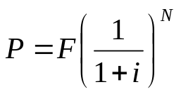
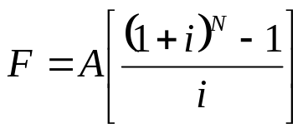
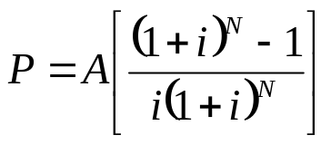
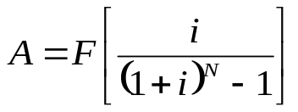
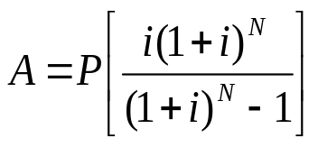
Interest Formulas
Finding F When Given P F= P(F/P,i%,N
Finding P When Given F P=F(P/F,i%,N)
Finding F When Given A
F=A(F/A,i%,N)
Finding P When Given A
P=A(P/A,i%,N)
Finding A When Given F
A=F(A/F,i%,N)
Finding A When Given P
A=P(A/P,i%,N)

Slide 6
Problems
Suppose that you borrow $8000 now, promising to repay the loan principle plus accumulated interest in four years at i=10% per year. How much you would repay at the end of four years?
An investor (owner) has an option to purchase a tract of land that will be worth $10,000 in six years. If the value of land increases at 8% each year, how much should the investor be willing to pay now for this property?
If a certain machine undergoes a major overhaul now, its output can be increased by 20% - which translates into additional cash flow of $20,000 at the end of each year for 5 years. If i=15% per year, how much can we afford to invest to overhaul this machine?

Slide 7
Problems
Suppose that your rich uncle has $1,000,000 that he wishes to distribute to his heirs at the rate of $100,000 per year.If the $1,000,000 is deposited in a bank account that earns 6%interest per year,How many years will it take to completely deplete the account?How long will it take if the account earns 8% interest per year instead of 6%.
An enterprising student is planning to have personal savings totaling $1000000 when she retires at age 65.She is now 20 years old.If the annual interest rate will average 7% over the next 45 years on her savings account, what equal end of year amount must she save to accomplish her goal.
Suppose you make 15 equal annual deposits of $1000 each into a bank account paying 5% interest per year.The first deposit will be made one year from today. How much money can be withdrawn from this bank account immediately after the 15th deposit.

Slide 8
Nominal and Effective Interest Rates
The Interest period or time between successive compounding is less than one year.
For example, if the interest is 6% per interest period and the interest period is six months, it is customary to speak of this rate as 12% compounded semiannually. Here the annual rate of interest is known as the nominal rate 12%.
The nominal interest rate is represented by r.
The actual annual rate on the principle is not 12% but something greater, because compounding occurs twice during the year.
The relationship between effective interest i and nominal interest rate, r is
i= (1+r/M)^{M} -1

Slide 9
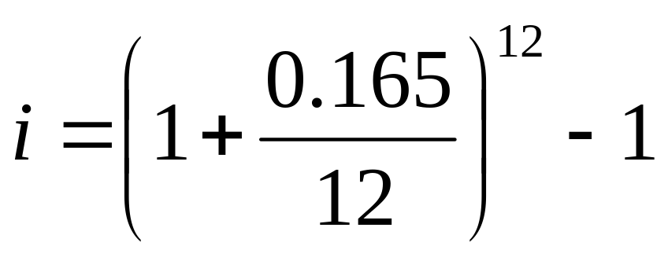
Example
A credit card company charges an interest rate of 1.375% per month on the unpaid balance of all the accounts. The annual interest rate, they claim is 12(1.375%) = 16.5%. What is the effective rate of interest per year being charged by the company?

